Slide 1
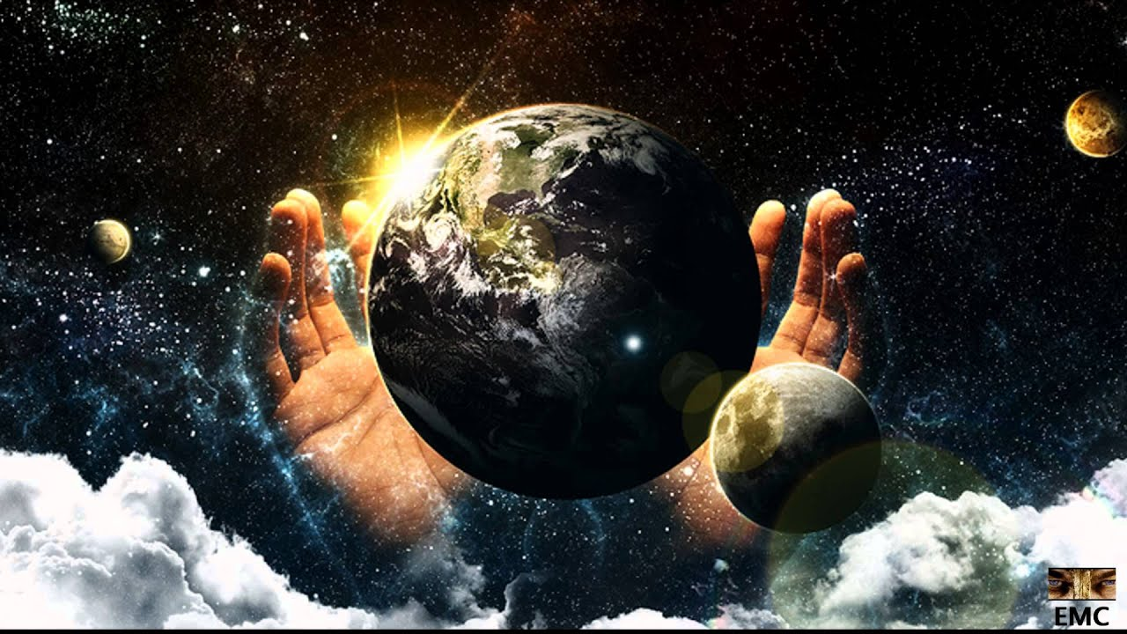
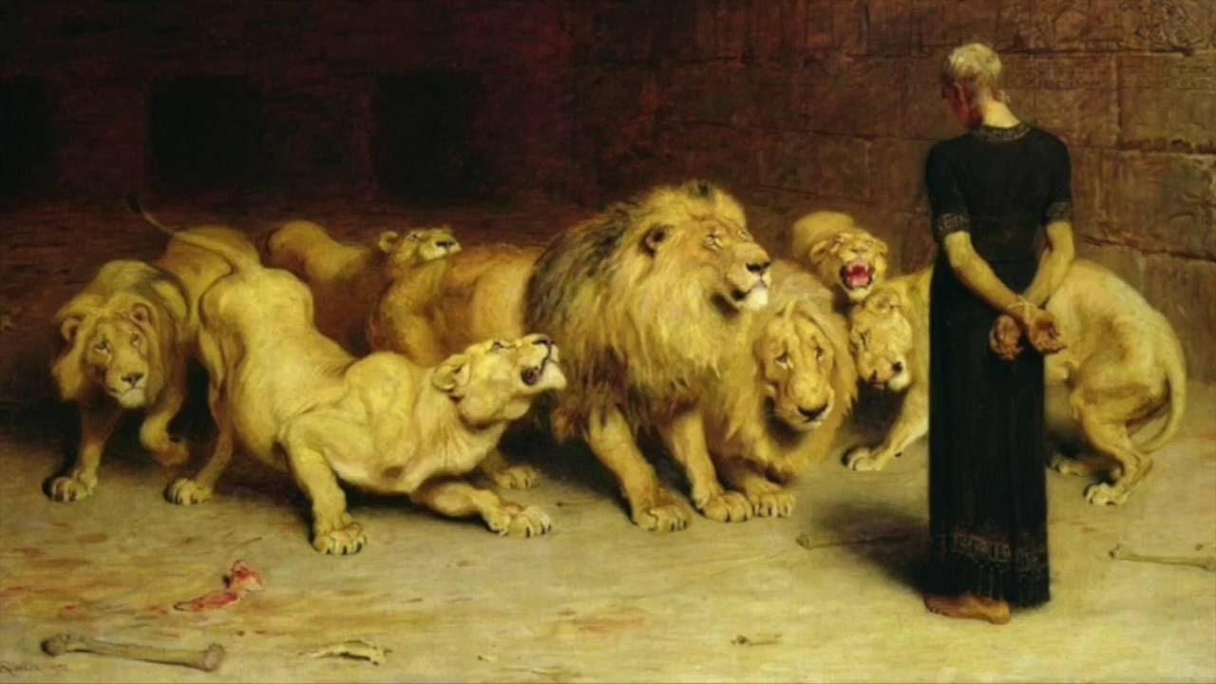
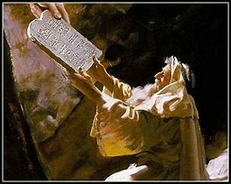
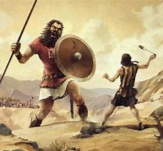
Old Testament Survey
Lesson 4 – The Exodus (Egypt to Canaan)
“….our tutor to bring us to Christ” (Gal 3:24)

Slide 2
Today’s Overview
Brief review of Genesis
Overview of Exodus – Deuteronomy
Character studies
Moses, the Israelites, the Lord
Evidences
Leading to Jesus
Close

Slide 3
Review – Genesis (“origins”)
Genesis 1-11
4 events:
Creation
The Fall
The Flood
Babel / The Dispersion
Leading to Jesus
Gen 1:26
“Let Us”
Gen 3:15
“bruise your head….bruise His heel”
Genesis 12-50
4 people:
Abraham
Isaac
Jacob / Israel
Joseph / Jacob’s sons
Leading to Jesus
Gen 12:3
“….in you all the families of the earth shall be blessed”
Gen 22
The sacrifice of Isaac
Gen 49:10
Judah: The scepter and lawgiver shall not depart until Shiloh comes

Slide 4
Structure of the Old Testament
Section | Key Topics
Genesis - Deuteronomy | Creation through the exodus Books of the law
Joshua - Ruth | Conquest of Canaan through the time of the judges
1 Samuel – 2 Chronicles | The time of the kings, the divided kingdom, and the captivity
Ezra - Esther | The return to Judah
Psalms – Song of Solomon | Books of poetry and wisdom
Isaiah - Daniel | Major prophets
Hosea - Malachi | Minor prophets

Slide 5
Summary of OT Bible Chronology (In Round Numbers)
Event | Approximate Date
Creation | ~4,200 BC
Noah / The Flood | ~2,600 BC
Joseph / Israel to Egypt | ~2,000 BC
Moses / Exodus from Egypt | ~1,500 BC
Solomon / 4th year of his reign | 970 BC
The Babylonian captivity | ~606 BC
Return to Judah | ~536 BC
Birth of Christ | ~3 BC

Slide 6
Summary of OT Bible Chronology (In Round Numbers)
Event | Approximate Date
Creation | ~4,200 BC
Noah / The Flood | ~2,600 BC
Joseph / Israel to Egypt | ~2,000 BC
Moses / Exodus from Egypt | ~1,500 BC
Solomon / 4th year of his reign | 970 BC
The Babylonian captivity | ~606 BC
Return to Judah | ~536 BC
Birth of Christ | ~3 BC

Slide 7
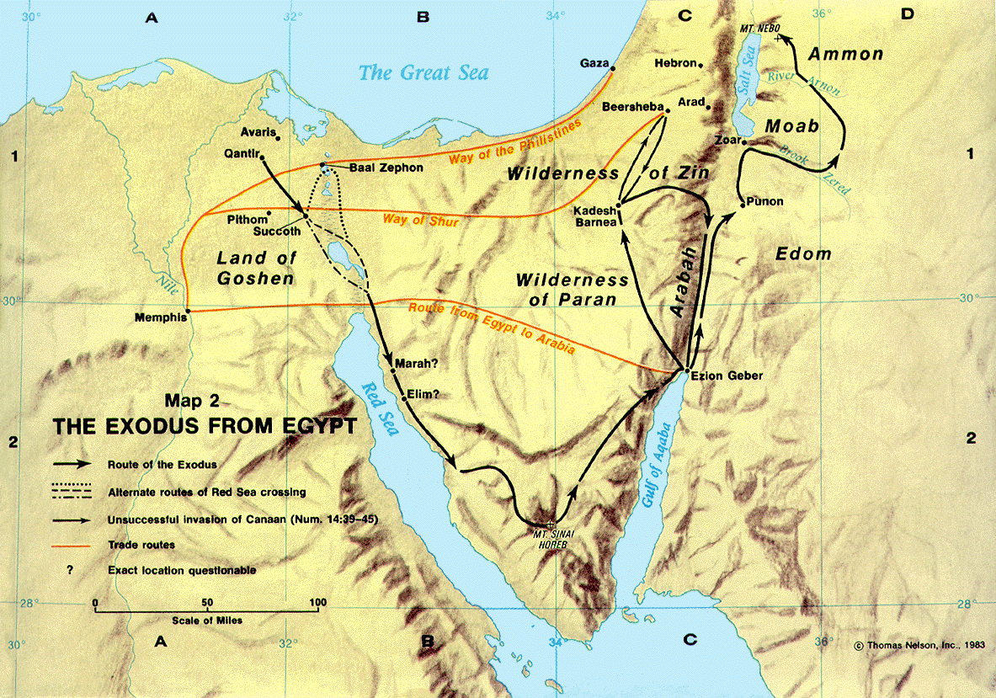
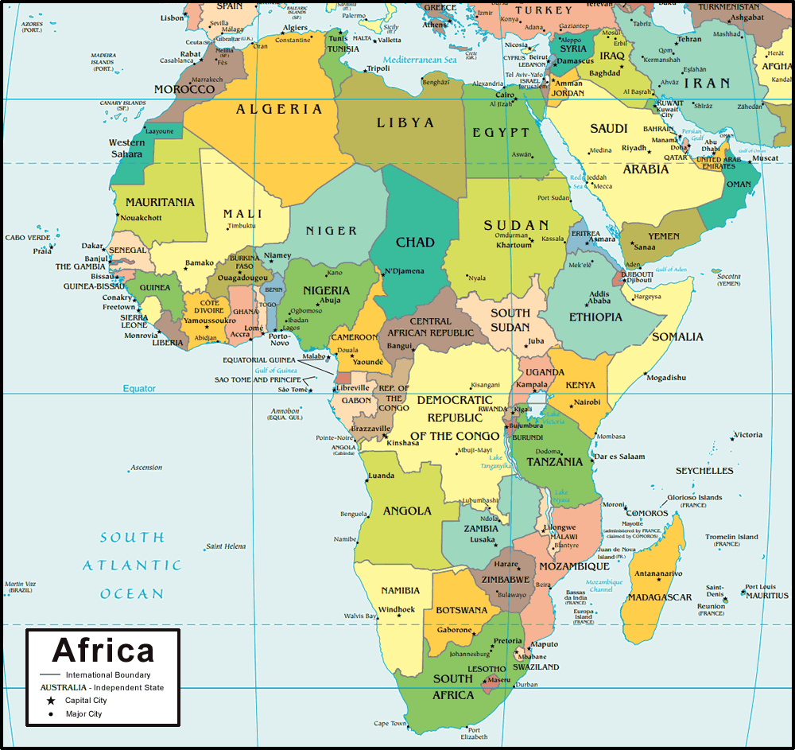
Map of the Exodus
Deuteronomy
Exodus
Numbers
Leviticus

Slide 8
Outline of the Exodus (1)
Exodus (“going out”)
From Egypt to Mt Sinai
Exodus starts year 1, month 1, day 15
Birth of Moses, appointment by God
Moses leads Israel from Egyptian slavery
Egypt is judged with the 10 plagues and the destruction of its army
The law and covenant are given
Moses 40 days and 40 nights on the mount
Israel: “All the words which the Lord has said we will do”
The issue of idolatry begins: the golden calf
Leviticus (“relating to the Levites”)
Occurs at Mt Sinai
Extensive Levitical laws
Aaron and his sons are consecrated
The priestly ministry begins
Disobedience and a harsh example: the death of Nadab and Abihu

Slide 9
Outline of the Exodus (2)
Numbers (“numbering”, or “census”)
From Mt Sinai to the edge of Canaan over ~40 years
Leave Sinai year 2, month 2, day 20
Arrive Canaan year 40, month 11, day 1
First census at Sinai: 625,550
Second census before Canaan: 624,730
The people refuse to go into Canaan
Punished to wander in the wilderness for 40 years
All those 20 and over die in the wilderness
Multiple uprisings against Moses
The people complain repeatedly
The people commit harlotry and idolatry
Moses sins by striking the rock for water
Initial combat
King Arad (Canaanites), King Sihon (Amorites), King Og (Bashan), Midianites

Slide 10
Outline of the Exodus (3)
Deuteronomy (“second law”)
Occurs on the east edge of Canaan
Moses recounts the exodus, the law, and God’s covenant with the Israelites
Exhortations for the Israelites
Totally destroy the Canaanites and their idolatry
Obey God’s commandments! Don’t forget! Teach your children!
Blessings if you obey, curses if you are disobedient
The coming Prophet
Joshua selected as the new leader
Death of Moses

Slide 11
Character Studies (1)
Moses
Royal upbringing, then a shepherd, then a prophet and leader of God’s people
Initially tried to avoid leadership
Humble
Num 12:3. “Now the man Moses was very humble, more than all men who were on the face of the earth.”
Interceded and offered himself for the people multiple times
Ex 32:11,32. “pleaded with the Lord”, “blot me out”
Num 12:13. “Please heal her, O God, I pray.”
Num 14:19. “Pardon the iniquity of this people”
Num 16:22. “shall one man sin, and You be angry with all the congregation?”
Num 21:7. So Moses prayed for the people.

Slide 12
Character Studies (2)
Moses (continued)
Summary statement
Deut 34:10-12. “But since then there has not arisen in Israel a prophet like Moses, whom the Lord knew face to face, in all the signs and wonders which the Lord sent him to do in the land of Egypt, before Pharaoh, before all his servants, and in all his land, and by all that mighty power and all the great terror which Moses performed in the sight of all Israel.”

Slide 13
Character Studies (3)
The Israelites
How many?
Estimates around 1.5M-2.0M
Deut 1:10. “here you are today, as the stars of heaven in multitude”
Traits:
Complainers
Idolators
Full of lust
Longing to return to Egypt
Doubting the Lord
Quick to turn from God and sin
Examples for us
1 Cor 10:6-11
Luke 9:62. But Jesus said to him, "No one, having put his hand to the plow, and looking back, is fit for the kingdom of God."

Slide 14
Character Studies (4)
The Lord
Loved His people
Deut 4:37
Saved His people
Deut 26:8
Provided for His people
Deut 29:5
Hates sin and disobedience
Multiple threats to eliminate them all and start over with Moses
Ex 32:10; Num 14:21; Num 16:21; Num 25:11
Full of mercy for those that love and obey Him
Deut 7:9

Slide 15
Historical Evidences
Skeletons of infants of three months old and younger, usually several in one box, buried under homes in a slave town called Kahun (Exodus 1:16), corresponding to Pharaoh’s slaughter of Hebrew infants.
Masses of houses and shops in Kahun, abandoned so quickly that tools, household implements, and other possessions were left behind. The findings suggest the abandonment was total, hasty, and done on short notice (Exodus 12:30–34, 39), consistent with the Israelites’ sudden exit from Egypt in the wake of Passover.
The Ipuwer Papyrus, a work of poetry stating, in part, “Plague stalks through the land and blood is everywhere. . . . Nay, but the river is blood . . . gates, columns and walls are consumed with fire . . . the son of the high-born man is no longer to be recognized. . . . The stranger people from outside are come into Egypt. . . . Nay, but corn has perished everywhere.”

Slide 16
Historical Evidences (2)
Discoveries also include evidence of cities such as Jericho being conquered during that timeframe.
The army of Amenhotep notably stopped military campaigns in 1446 BC (Exodus 14:28).

Slide 17
Focus Events
Rebellion of Korah (Num 16)
“You [Korah] take too much upon yourself”
"By this you shall know that the Lord has sent me to do all these works, for I have not done them of my own will. “
Moses strikes the rock (Num 20)
"Because you did not believe Me, to hallow Me in the eyes of the children of Israel, therefore you shall not bring this assembly into the land which I have given them."
The greatest commandment (Deut 6) / Circumcise your hearts (Deut 10)
"Hear, O Israel: The Lord our God, the Lord is one! You shall love the Lord your God with all your heart, with all your soul, and with all your strength.
“Therefore circumcise the foreskin of your heart, and be stiff-necked no longer.”

Slide 18
Leading us to Christ
Brass serpent
John 3:14-15. And as Moses lifted up the serpent in the wilderness, even so must the Son of Man be lifted up, 15 that whoever believes in Him should not perish but have eternal life.
A prophet like unto me
Deut 18:15-20. "The Lord your God will raise up for you a Prophet like me from your midst, from your brethren. Him you shall hear….I will raise up for them a Prophet like you from among their brethren, and will put My words in His mouth, and He shall speak to them all that I command Him. And it shall be that whoever will not hear My words, which He speaks in My name, I will require it of him.
Moses led from Egypt, Jesus leads from sin

Slide 19
Date | Lesson Topic | Class Leader
Dec 1 (W) | Why study the OT? Theme of the OT. OT Summary. | Rick
Dec 5 (S) | Genesis (part 1) | Jordan
Dec 8 (W) | Genesis (part 2) | Jordan
Dec 12 (S) | The Exodus (Egypt to Canaan) | Rick
Dec 15 (W) | The Law | Rick
Dec 19 (S) | Joshua and Judges (part 1) | Jordan
Dec 22 (W) | Joshua and Judges (part 2) | Jordan
Dec 26 (S) | The United Kingdom: Saul, David, and Solomon | Rick
Jan 2 (S) | The Divided Kingdom: Israel | Jordan
Jan 5 (W) | The Divided Kingdom: Judah | Rick
Jan 9 (S) | Books of Poetry and Wisdom | Jordan
Jan 12 (W) | Major Prophets: Isaiah, Jeremiah, Lamentations, Ezekiel, Daniel | Rick
Jan 16 (S) | Brief OT summary, between the testaments | Jordan

Slide 20
Thanks

Slide 21
Backup Material

Slide 22
Date | Lesson Topic | Class Leader
Dec 1 (W) | Why study the OT? Theme of the OT. OT Summary. | Rick
Dec 5 (S) | Genesis (part 1) | Jordan
Dec 8 (W) | Genesis (part 2) | Jordan
Dec 12 (S) | The Exodus (Egypt to Canaan) | Rick
Dec 15 (W) | The Law | Rick
Dec 19 (S) | Joshua and Judges (part 1) | Jordan
Dec 22 (W) | Joshua and Judges (part 2) | Jordan
Dec 26 (S) | The United Kingdom: Saul, David, and Solomon | Rick
Jan 2 (S) | The Divided Kingdom: Israel | Jordan
Jan 5 (W) | The Divided Kingdom: Judah | Rick
Jan 9 (S) | Books of Poetry and Wisdom | Jordan
Jan 12 (W) | Major Prophets: Isaiah, Jeremiah, Lamentations, Ezekiel, Daniel | Rick
Jan 16 (S) | Brief OT summary, between the testaments | Jordan

